Slide 1


H
O
M
E
1
4
2
1
S
C
O
R
E
1
4
2
1
1

Slide 2

S
C
O
R
E
1
4
2
1
1
S
C
O
R
E
M
A
N
Y
1
4
2
1
1
4
2
1
1

Slide 3


S
C
O
R
E
1
4
2
1
1
S
C
O
R
E
M
A
N
Y
1
4
2
1
1
4
2
1
1

Slide 4

S
C
O
R
E
1
4
2
1
1
S
C
O
R
E
M
A
N
Y
1
4
2
1
1
4
2
1
1

Slide 5

S
C
O
R
E
1
4
2
1
1
S
C
O
R
E
M
A
N
Y
1
4
2
1
1
4
2
1
1

Slide 6

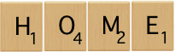
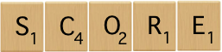
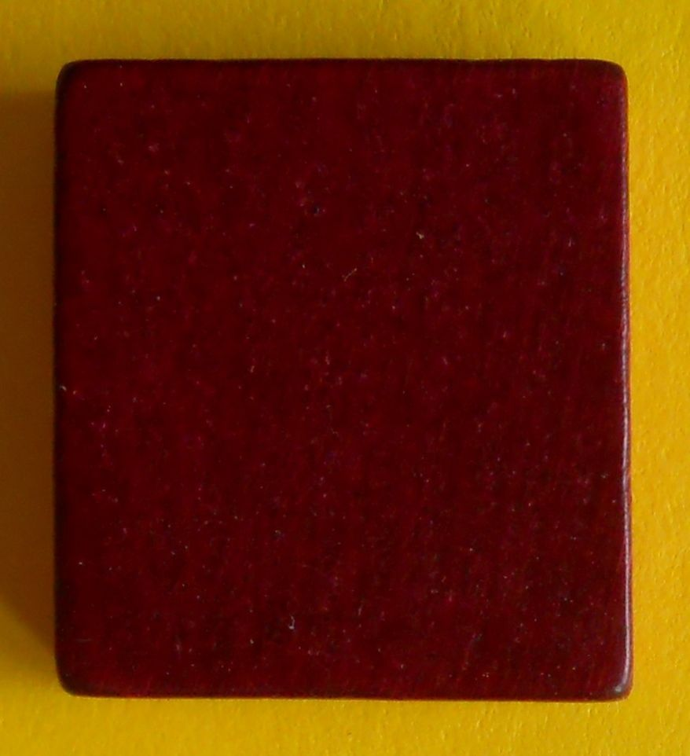











iT
S
C
O
R
E
1
3
1
1
1
background-size: cover;
S
C
M
O
A
R
N
E
Y
1
4
4
2
2
1
1
1
1
RESET
Score it
RESET
Score it
Score it

Slide 7
